Slide 1
FFN Fusion:
Accelerating Large Language Models

Slide 2
Why LLMs Are Slow
Large Language Models (LLMs) like GPT-4 and LLaMA are powerful but computationally intensive.
Inference (generating outputs) is slow due to the sequential nature of Transformer architectures.
Each layer waits for the previous one to complete, leading to latency and high computational costs.
Quantization/pruning help but have trade-offs

Slide 3
Transformers Architecture
Transformers consist of stacked layers, each with:
Multi-Head Attention: Captures relationships between tokens.
Feed-Forward Network (FFN): Processes each token independently.
Despite parallelism in attention heads, layers are processed sequentially.

Slide 4
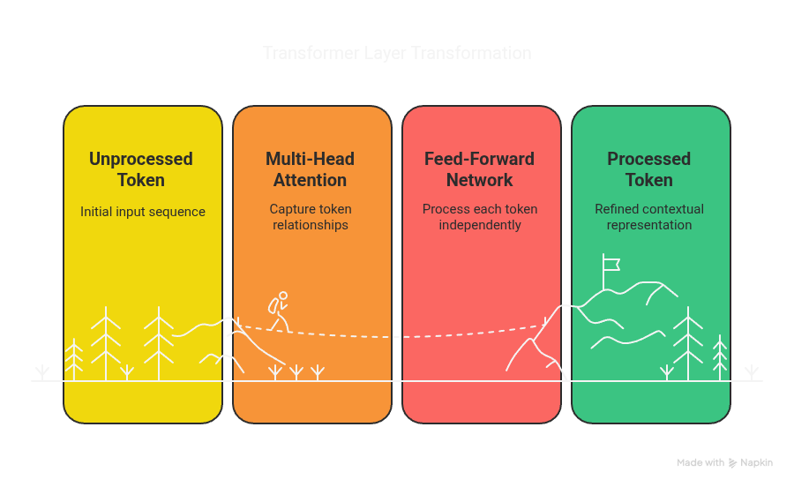

Slide 5
Existing Optimization Techniques
Quantization: Reduces precision of weights to lower computational load.
Pruning: Removes less important weights or neurons.
Mixture of Experts (MoE): Activates only parts of the model per input.
Limitations: These methods often compromise accuracy or require large batch sizes.

Slide 6
Introducing Puzzle
Puzzle is a tool that prunes redundant attention layers in Transformers.
After pruning, sequences of FFN layers remain, presenting an opportunity for optimization.
Leaves long chains of FFNs

Slide 7
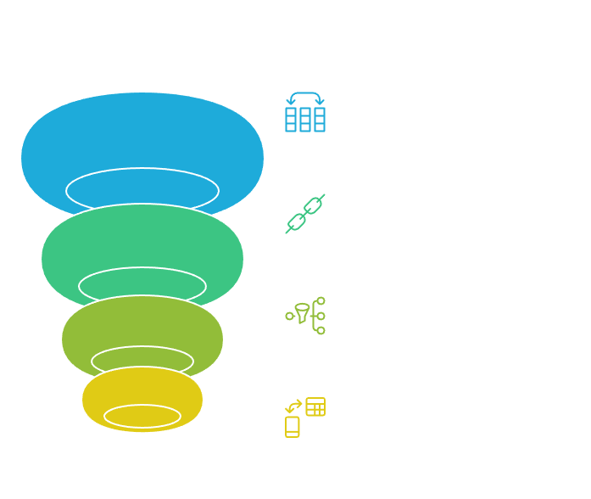

Slide 8
What is FFN Fusion?
FFN Fusion is an architectural optimization that allows multiple FFN layers to be executed in parallel.
Key insight: Consecutive FFN layers often have low interdependencies.
Instead of FFN1 → FFN2 → FFN3 sequentially, Sum Outputs.
Collapsible into one wide FFN layer
Eliminates sync points, boosts GPU utilization

Slide 9
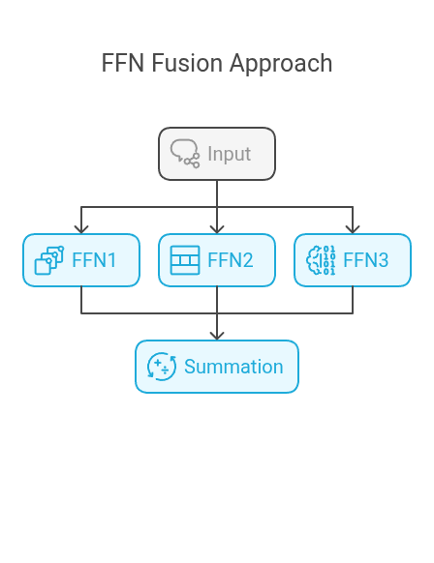
How Does FFN Fusion Work?
Traditional approach: FFN1 → FFN2 → FFN3 (sequential processing).
FFN Fusion approach: FFN1, FFN2, FFN3 receive the same input simultaneously; their outputs are summed.
This can be represented as a single, wider FFN layer.

Slide 10
Benefits of FFN Fusion
Reduces inference latency by enabling parallel computation.
Improves hardware utilization, especially on GPUs.
Maintains model accuracy with minimal or no loss.

Slide 11
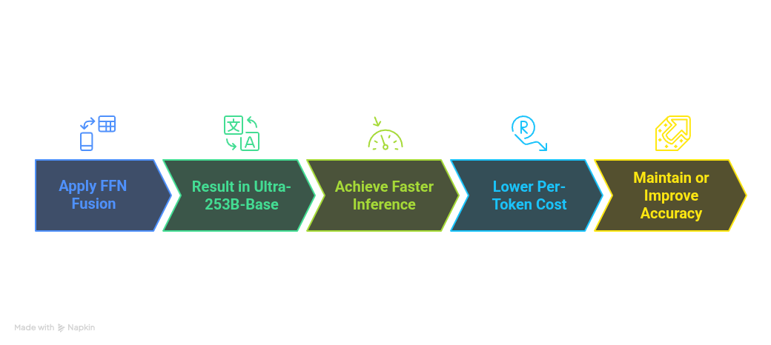
Case Study: Ultra-253B-Base

Slide 12
Experimental Findings
FFN Fusion effective across various model sizes, including smaller models like 70B.
Fusion outperforms simple removal of FFN layers in maintaining accuracy.
Final FFN layers are more sensitive; caution needed when fusing them.

Slide 13
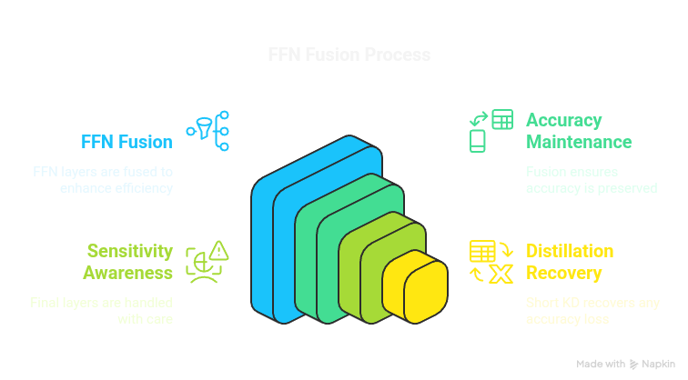

Slide 14
Beyond FFN Fusion:
Block Parallelization
Explored fusing entire Transformer blocks (including attention and FFN).
Found to be less effective due to higher interdependencies.
Indicates potential for future research but not yet practical.

Slide 15
Conclusions and Future Directions
FFN Fusion offers a promising path to more efficient LLMs.
Complements existing optimization techniques.
Opens avenues for designing models with inherent parallelism.

Slide 16
Thanks!
Do you have any questions?

